Slide 1
HDL Part VII
陳培殷
國立成功大學 資訊工程系

Slide 2
Modern Design (1/2)
Modern design is composed of (1) Datapath and
(2) Controller (control unit or control path)
Control
Datapath
inputs
inputs
Control
signals
(Note)
Control
Datapath
unit
Status
signals
Control
Datapath
outputs
outputs

Slide 3
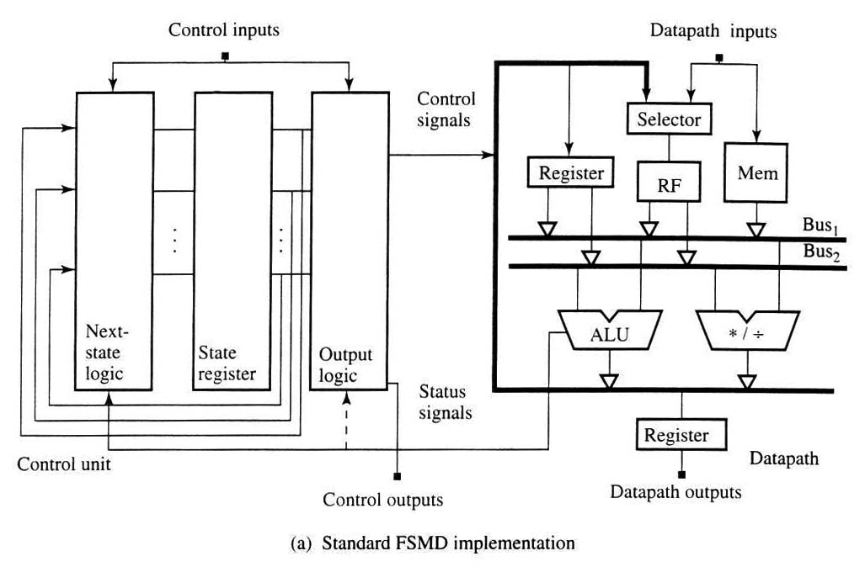
Modern Design (2/2)
Register-transfer-level block diagram
C: Combinational circuit
S: Sequential circuit
C
Q
S
D
S
.
.
C
C
Q
D
S
C
C
Control Unit
Datapath

Slide 4
Optimization for RTL Design
Optimization for control unit:
1. As suggestion by most textbooks
of “Logic System Design”
2. Write a good-style HDL descriptions
which are optimized by EDA tools

Slide 5
Optimization for Control Unit
Design description or
timing diagram
Traditional optimization
flow for control unit
Develop
state diagram
Derive
excitation equation
Develop next-state
and output tables
Optimize
logic circuit
Control Unit
Finite State Machine
(FSM)
Minimize states
Derive logic schematic
and timing diagram
Encode input, states,
and outputs
Simulation
Decide the
memory elements
Functional verification
and timing analysis

Slide 6
Finite State Machine (1/4)
Moore machine: (output is dependent only on current state)
Mealy machine: (output is dependent on input and state)
State diagram
Next-state and output tables (I=input)
Four states: S₀, S₁, S₂, S₃
Input/Output
Present State | Next State |  | Output
 | I=0 | I=1 | I=0 | I=1
S₀ | S₀ | S₁ | 0 | 1
S₁ | S₁ | S₂ | 1 | 0
S₂ | S₂ | S₀ | 0 | 1
S₃ | S₃ | S₁ | 0 | 1
0/0
S₀
1/1
1/1
1/1
0/0
S₂
S₁
S₃
A mealy machine
Initial state
0/0
1/0
0/1
Input/Output

Slide 7
Finite State Machine (2/4)
inputs
Next State Logic
(combinational)
Current State Register
(sequential)
Output Logic
(combinational)
clock
Moore
output
asynchronous reset
Moore Machine (state-based machine)
inputs
Next State Logic
(combinational)
Current State Register
(sequential)
Output Logic
(combinational)
clock
Mealy
output
asynchronous reset
Mealy Machine (input-based machine)

Slide 8
Finite State Machine (3/4)
For best legibility, describe FSM using two or three always@ statements
(1) current state or state register (sequential circuit)
(2) next state logic (combinational circuit)
(3) output logic (combinational circuit)
Two combinational logic can be merged
Use parameter to describe the state name
Reset
Y=1
ST0
Control=0
Y=4
ST3
ST1
Y=2
Control=1
Y=3
ST2

Slide 9
Finite State Machine (4/4)
always @(Control or Currentstate)
begin
NextState = ST0;
case (CurrentState)
ST0: NextState <= ST1;
ST1: if (Control)
NextState <= ST2;
else
NextState <= ST3;
ST2: NextState <= ST3;
ST3: NextState <= ST0;
endcase end
always @(CurrentState)
begin
case(CurrentState)
ST0: Y <= 1; ST1: Y <= 2;
ST2: Y <= 3; ST3: Y <= 4;
endcase
end endmodule
module FSM(Clock, Reset, Control, Y)
input Clock, Reset, Control;
output [2:0] Y;
reg [1:0] CurrentState, Nextstate;
reg [2:0] Y;
parameter [1:0] ST0 = 2’b00,
ST1 = 2’b01,
ST2 = 2’b10,
ST3 = 2’b11;
always @(posedge Clock or posedge Reset)
if (Reset)
CurrentState <= ST0;
else
CurrentState <= NextState;
Next state
logic
(Comb.C.)
Reset
Y=1
ST0
State name
(parameter)
Y=2
Control=0
Y=4
ST3
ST1
Y=3
ST2
Control=1
State
register
(Seq.C.)
Output
logic
(Comb.C.)

Slide 10
Moore Machine (1/2)
Optimization flow
Next-state and output tables (I=input)
Design description or
timing diagram
Present State | Next State |  | Output
 | I=0 | I=1 | I=0 | I=1
S₀ | S₀ | S₂ | 0 | 0
S₁ | S₀ | S₂ | 1 | 1
S₂ | S₂ | S₃ | 1 | 1
S₃ | S₃ | S₁ | 0 | 0
Develop
state diagram
Derive
excitation equation
Develop next-state
and output tables
Optimize
logic circuit
0/0
Minimize states
Derive logic schematic
and timing diagram
S₀
0/1
1/0
Encode input, states,
and outputs
Simulation
0/1
S₁
1/1
S₂
Decide the
memory elements
Functional verification
and timing analysis
0/0
S₃
1/1
1/0

Slide 11
Moore Machine (2/2)
always @(In_Data or State)
begin
case(State)
S0: begin
if(In_Data == 1)
NextState = S2;
else
NextState = S0;
end
S1:begin
if(In_Data == 1)
NextState = S2;
else
NextState = S0;
end
S2: begin
if(In_Data == 1)
NextState = S3;
else
NextState = S2;
end
S3: begin
if(In_Data == 1)
NextState = S1;
else
NextState = S3;
end
endcase
end
always @(State)
begin
case(State)
S0:Out_Data = 0;
S1:Out_Data = 1;
S2:Out_Data = 1;
S3:Out_Data = 0;
endcase
end
endmodule
module moore_good(Clk,
Reset, In_Data, Out_Data);
input Clk, Reset, In_Data;
output [1:0] Out_Data;
reg [1:0] Out_Data;
reg [1:0] State, NextState;
parameter S0=2'b00, S1=2'b01,
S2=2'b10, S3=2'b11;
always @(posedge Clk or
posedge Reset)
begin
if(Reset)
State = S0;
else
State = NextState;
end
Present State | Next State |  | Output
 | I=0 | I=1 | I=0 | I=1
S₀ | S₀ | S₂ | 0 | 0
S₁ | S₀ | S₂ | 1 | 1
S₂ | S₂ | S₃ | 1 | 1
S₃ | S₃ | S₁ | 0 | 0
Next state logic
State register (flip-flops)
Output logic
Note: This is a good-style HDL (only “State” is implemented with flip-flops)

Slide 12
Traffic Light Controller (1/6)
Control Unit
Datapath
Comb.
Seq.
Comb.
4 2 0
Red
R_{t} G_{t} Y_{t}
Next
State
Logic
Output
Logic
Green
Counter
Yellow
Current_times
Comparator
State Registers
Recount_counter
Recount_counter
Input/Output
Recount_Counter16/Red Green Yellow
0/100
0/010
0/001
R_time: 4+1=5 cycles
G_time: 2+1=3 cycles
Y_time: 0+1=1 cycles
1/100
1/010
R
G
Y
1/001

Slide 13
Traffic Light Controller (2/6)
module traffic(Clock,Reset,Red,Green,Yellow);
input Clock,Reset; output Red,Green,Yellow;
wire Recount_conter; wire [3:0] Counter_Number;
Traffic_Control (.Clock(Clock),.Reset(Reset),
.Recount_Counter16(Recount_conter),.Red(Red),
.Green(Green),.Yellow(Yellow));
Datapath (.Clock(Clock), .Reset(Reset), .RGY({Red,Green,Yellow}),
.Recount(Recount_conter));
endmodule
module Datapath(Clock, Reset, RGY, Recount);
input Clock, Reset; input [2:0] RGY;
output Recount; wire [3:0] Counter_Number;
Compare A1(.current_times(Counter_Number), .RGY(RGY),
.Recount_conter16(Recount));
Counter16 A2(.Clock(Clock),.Reset(Reset),
.Recount_Counter16(Recount),.Count_Out(Counter_Number));
endmodule

Slide 14
Traffic Light Controller (3/6)
module Counter16(Clock,Reset,Recount_Counter16,
Count_Out);
input Clock,Reset,Recount_Counter16;
output [3:0] Count_Out;
reg [3:0] Count_Out;
always@(posedge Clock)
begin
if(Reset)
Count_Out=0;
else
begin
if(Recount_Counter16)
Count_Out=0;
else
Count_Out=Count_Out+1;
end
end
endmodule

Slide 15
Traffic Light Controller (4/6)
module compare(current_times,
RGY, Recount_conter16);
input [2:0] RGY;
input [3:0] current_times;
output Recount_conter16;
reg Recount_conter16;
parameter R_times=4, G_times=2,
Y_times=0;
always @(RGY)
begin
case(RGY)
3’b100:begin
if(current_times ==R_times)
Recount_conter16=1;
else
Recount_conter16=0;
end
3’b001:begin
if(current_times ==Y_times)
Recount_conter16=1;
else
Recount_conter16=0;
end
3’b010:begin
if(current_times ==G_times)
Recount_conter16=1;
else
Recount_conter16=0;
end
default: Recount_conter16=1;
endcase
end
endmodule

Slide 16
Traffic Light Controller (5/6)
always@(currentstate)
begin
case(currentstate)
Red_Light:begin
if(Recount_Counter16)
nextstate=Green_Light;
else
nextstate=Red_Light; end
Green_Light:begin
if(Recount_Counter16)
nextstate=Yellow_Light;
else
nextstate=Green_Light; end
Yellow_Light:begin
if(Recount_Counter16)
nextstate=Red_Light;
else
nextstate=Yellow_Light; end
default: nextstate=Red_Light;
endcase
end
module Traffic_Control(Clock,Reset,
Recount_Counter16,Red,Green,Yellow);
input Clock, Reset,Recount_Counter16;
output Red, Green, Yellow;
reg Red, Green, Yellow;
reg [1:0] currentstate,nextstate;
parameter [1:0] Red_Light=0, Green_Light=1,
Yellow_Light=2;
always@(posedge Clock)
begin
if(Reset)
currentstate = Red_Light;
else
currentstate = nextstate;
end
State Register (Seq. C.)
Next State Logic (Comb. C.)

Slide 17
Traffic Light Controller (6/6)
always @(currentstate)
begin
case(currentstate)
Red_Light:begin
Red=1'b1;
Green=1'b0;
Yellow=1'b0;
end
Green_Light:begin
Red=1'b0;
Green=1'b1;
Yellow=1'b0;
end
Yellow_Light:begin
Red=1'b0;
Green=1'b0;
Yellow=1'b1;
end
default:begin
Red=1'b0;
Green=1'b0;
Yellow=1'b0;
end
endcase
end
endmodule
Output Logic (Comb. C.)

